Slide 1

Smart Medicine Reminder For Elderly People

Slide 2
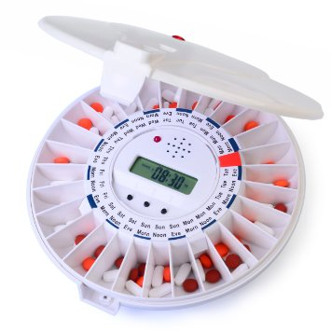
Description
Sometimes elderly people forget to take the medicine at the required time of medicines.
And sometimes they also forgets which medicine He / She have to take at required time. And it is difficult for Doctor/Compounder/ care
takers to monitor patients
around the clock.
To avoid this problem, we
have made this
medicine reminder system.

Slide 3
An app is build for the user (care taker) which enables him to set the time at which the person has to consume the tablet.
The time that is set by the user in the mobile app(which is built using MIT app inventor 2) is received by our Device(Node MCU and stores the data in EEPROM through IOP Address)and compares this time with the real time from ibm cloud.
If both gets matched then LED placed at particular slot will glow and a sound is generated by Buzzer.

Slide 4
Components Used
Hardware
Node MCU - It is a micro controller , using which we connect to wifi and interact with cloud
LED’S - these are used for indicating the specific tablet to be taken
Buzzer – gives a buzz sound reminding the person to take the tablet, this helps the person to take tablet on time
O-LED display – the medicine which has to be taken is displayed on the screen.

Slide 5
Software
Arduino IDE –
It is a cross-platform application, it supplies a software library from the Wiring project, which provides many common input and output procedures.
MIT app inventor 2
Node-RED (a flow-based development tool ) –
Node-RED provides a web browser-based flow editor, which can be used to create JavaScript functions.
Functions are written to retrieve the time from mobile app and compare with the real time using this flow editor.

Slide 6
WORKING
Connect LED , buzzer and O-LED display to Node MCU properly.
Upload the Arduino program into node MCU.
Set Day and Time in MIT mobile app and click on save button.
This data is Stored in EEPROM.
Check the time set by the user and comparing it with real time.
Buzzer as soon as the time matches.
LED’s Specifying which medicine to take on a given time.

Slide 7
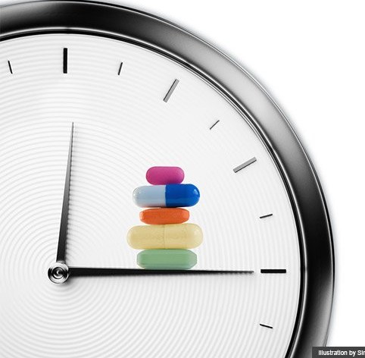
ADVANTAGES
Reminds Our Seniors to Take Their Medication regularly
Prevent Errors
All in One Place
Easy to Use
Customization

Slide 8


